Slide 1
Inertial Measurement Unit (IMU)
Andrew Ross

Slide 2
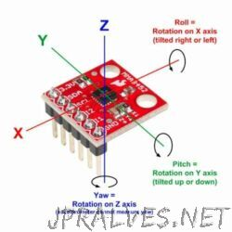
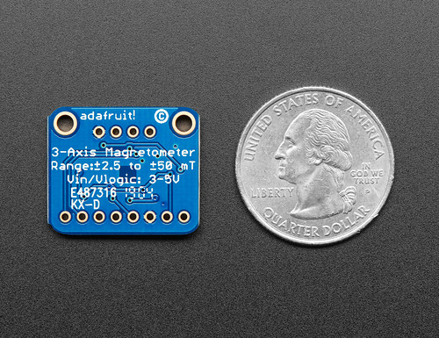
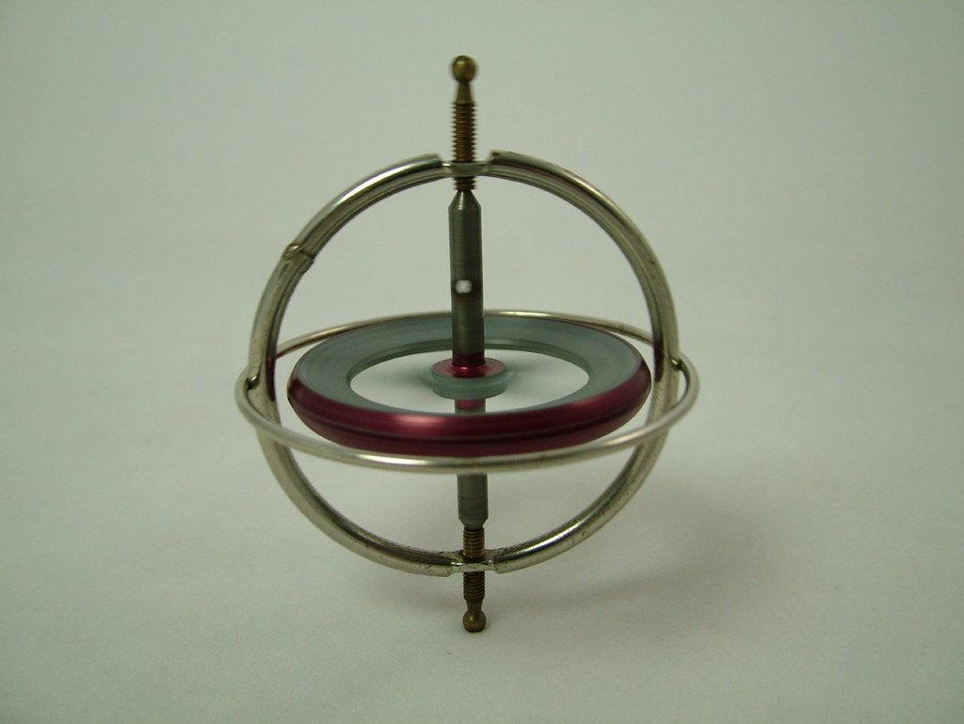
What is an IMU
IMU is a device that can measure and report specific gravity and angular rate of an object to which it is attached.
Gyroscopes: providing a measure angular rate
Accelerometers: providing a measure specific force/acceleration
Magnetometers (optional): measurement of the magnetic field surrounding the system
This Photo by Unknown Author is licensed under CC BY-SA-NC
This Photo by Unknown Author is licensed under CC BY-SA-NC
This Photo by Unknown Author is licensed under CC BY-NC-ND
Notes:
Used in some smartphones
Used for military purposes like
Quaternions is an expression of the form a+bi+cj+dk, where a, b, c, d, are real numbers, and i, j, k, are symbols that can be interpreted as unit-vectors pointing along the three spatial axes. In practice, if one of a, b, c, d is 0, the corresponding term is omitted; if a, b, c, d are all zero, the quaternion is the zero quaternion, denoted 0; if one of b, c, d equals 1, the corresponding term is written simply i, j, or k.
Hamilton describes a quaternion, as consisting of a scalar part and a vector part. The quaternion is called the vector part (sometimes imaginary part) of q, and a is the scalar part (sometimes real part) of q. A quaternion that equals its real part (that is, its vector part is zero) is called a scalar or real quaternion, and is identified with the corresponding real number. That is, the real numbers are embedded in the quaternions.
a UAV (unmanned aerival visuals)

Slide 3
Data
Dependent Variable
Quarterions 0-3
Independent Variables
Gyro x, y, z
Accelerometer x, y, z
Magnometer x, y, z

Slide 4
EDA
Notes:
Start with independent variables first and then dependent

Slide 5
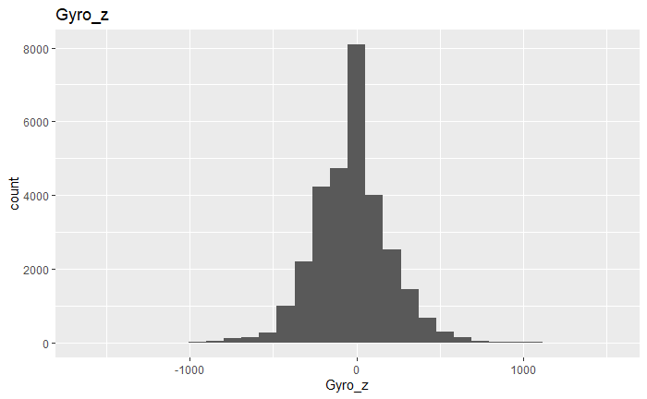
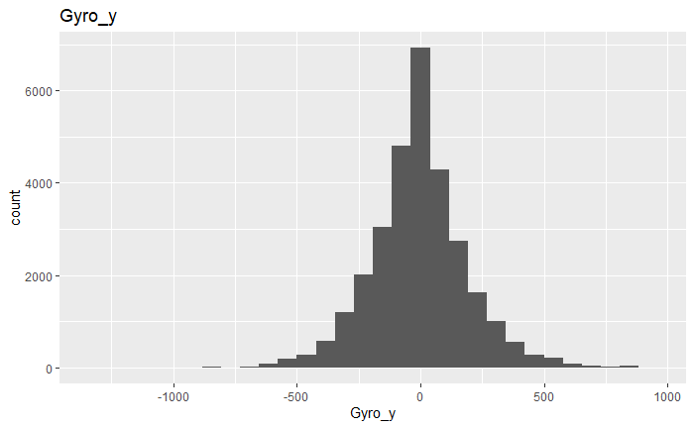
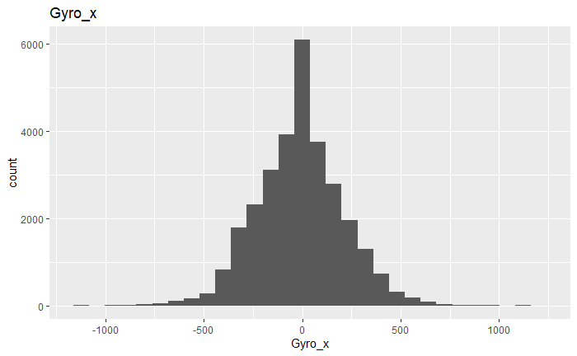
Gyro

Slide 6
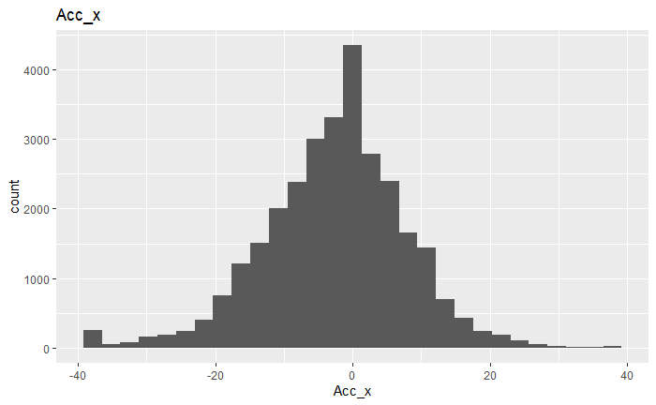
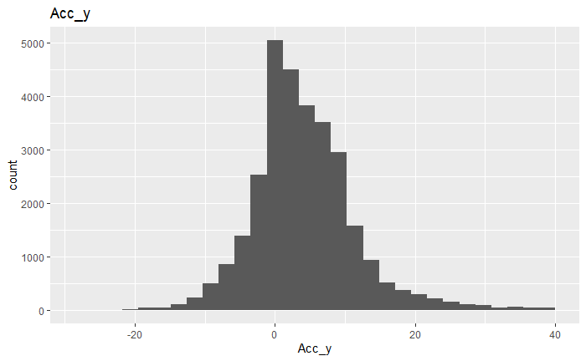
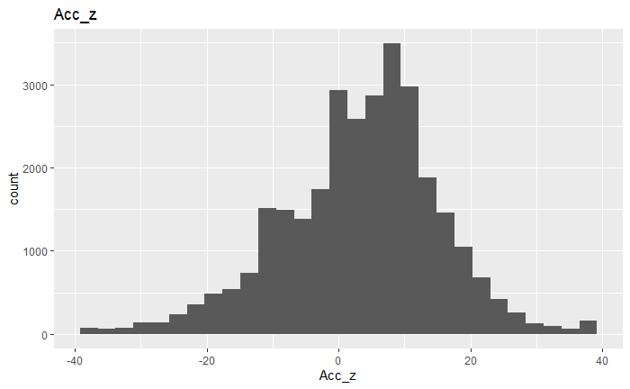
Accelerometer

Slide 7
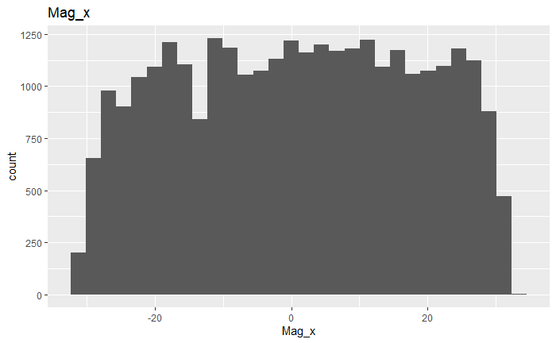
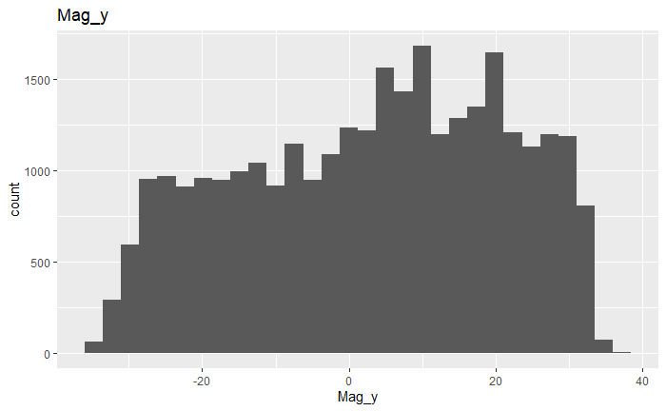
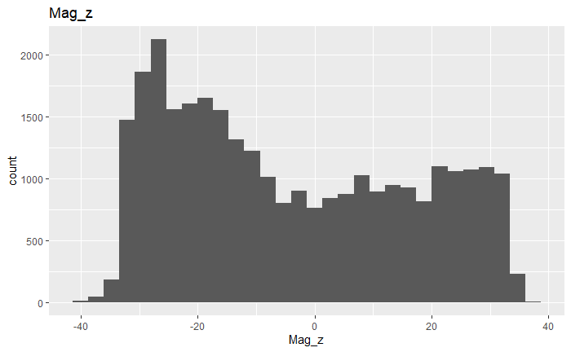
Magnometer

Slide 8
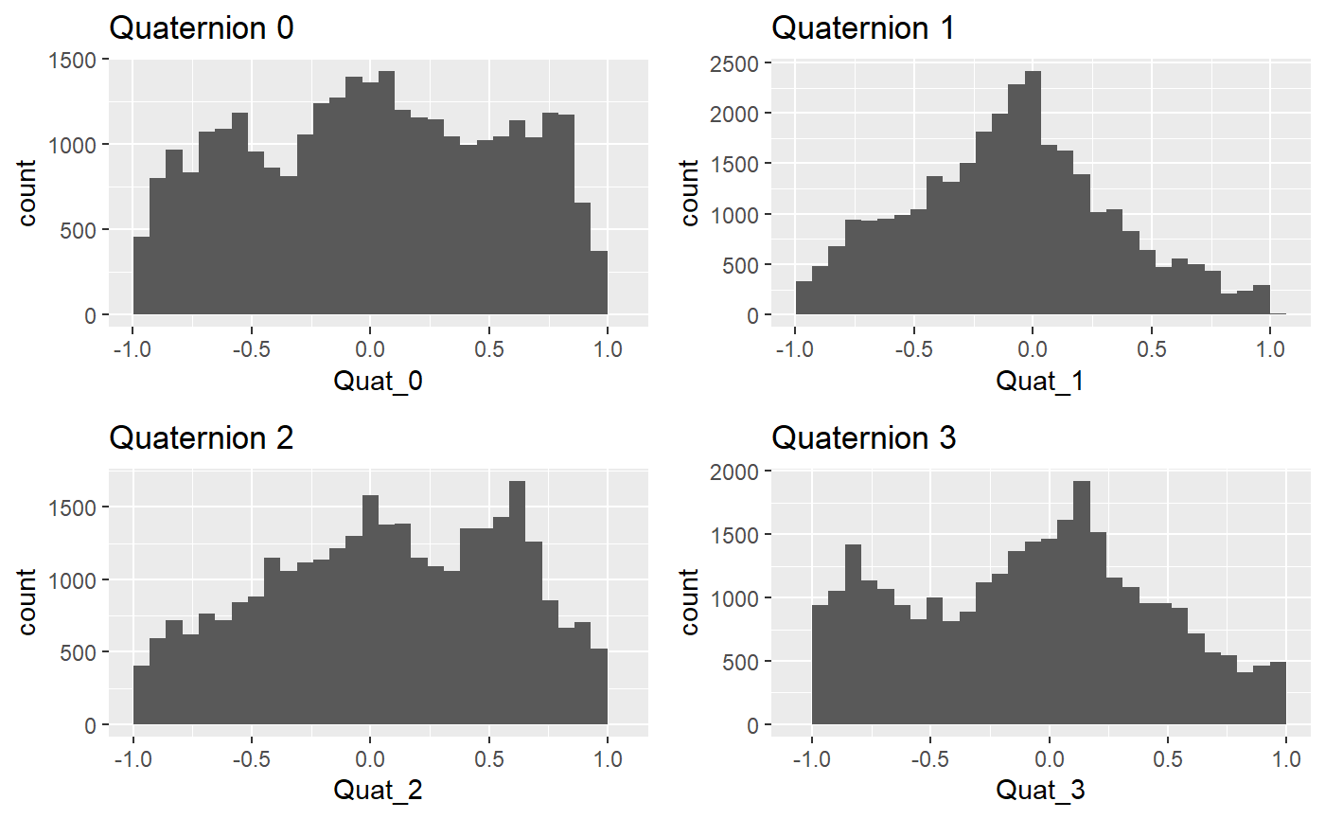
Quaternions

Slide 9
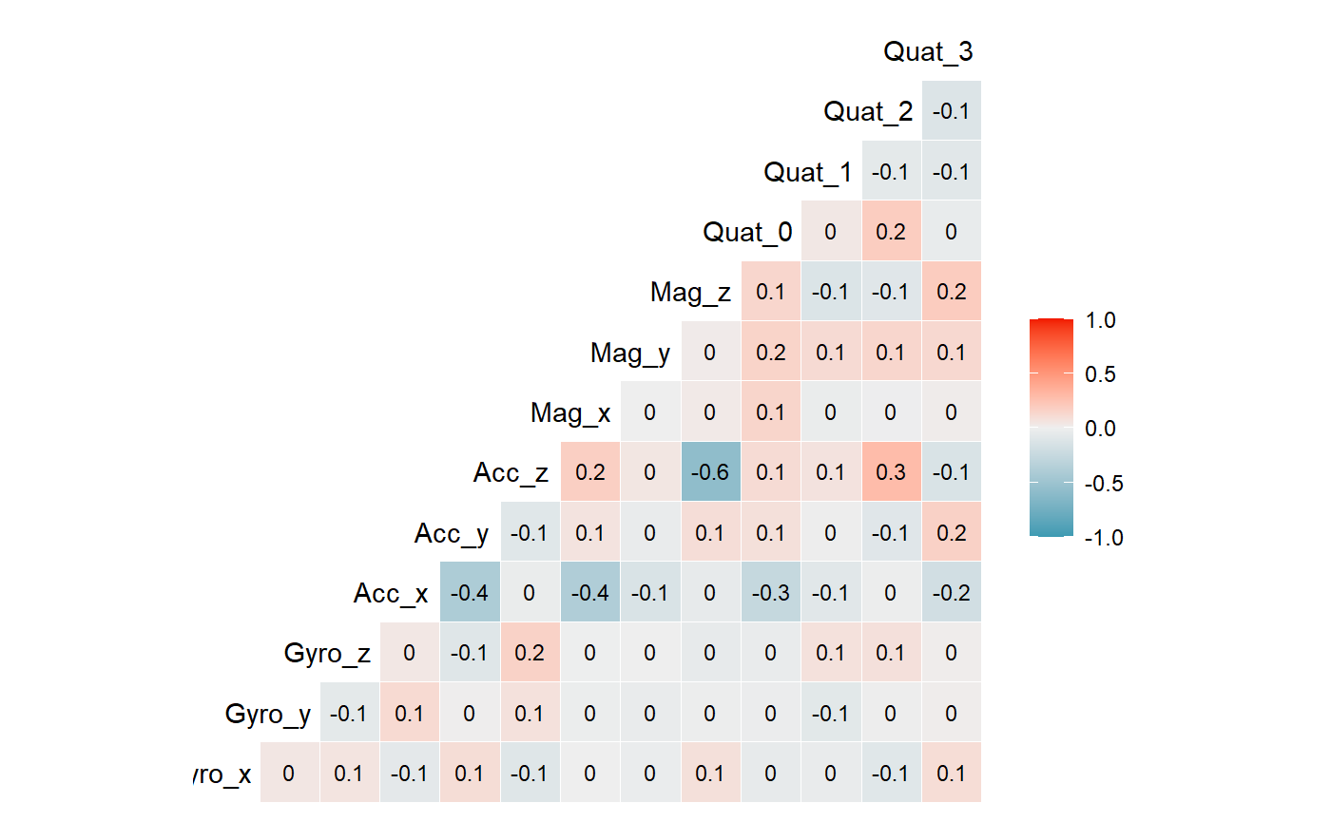

Slide 10
Model Building

